Slide 1
Hadoop and Spark Programming Environments
Yubao Wu

Slide 2
Cloudera CDH 5.8
Virtualized clusters for easy installation on your desktop!
Cloudera QuickStart for Docker (multi-node cluster) and Cloudera QuickStart VM (single-node cluster) make it easy to quickly get hands-on with CDH for testing, demo, and self-learning purposes, and include Cloudera Manager for managing your cluster. Cloudera QuickStart VM also includes a tutorial, sample data, and scripts for getting started.

Slide 3
Installing Cloudera CDH 5.8
1. Download and Install virtual box. It is free.
https://www.virtualbox.org/wiki/Downloads
Download QuickStarts for CDH 5.8 for the Platform Virtual Box. It is a free Hadoop distribution.
http://www.cloudera.com/downloads/quickstart_vms/5-8.html
3. Install CDH 5.8
4. Run the Virtual Machine and Hadoop.
Windows, Linux, and Mac are all supported.

Slide 4
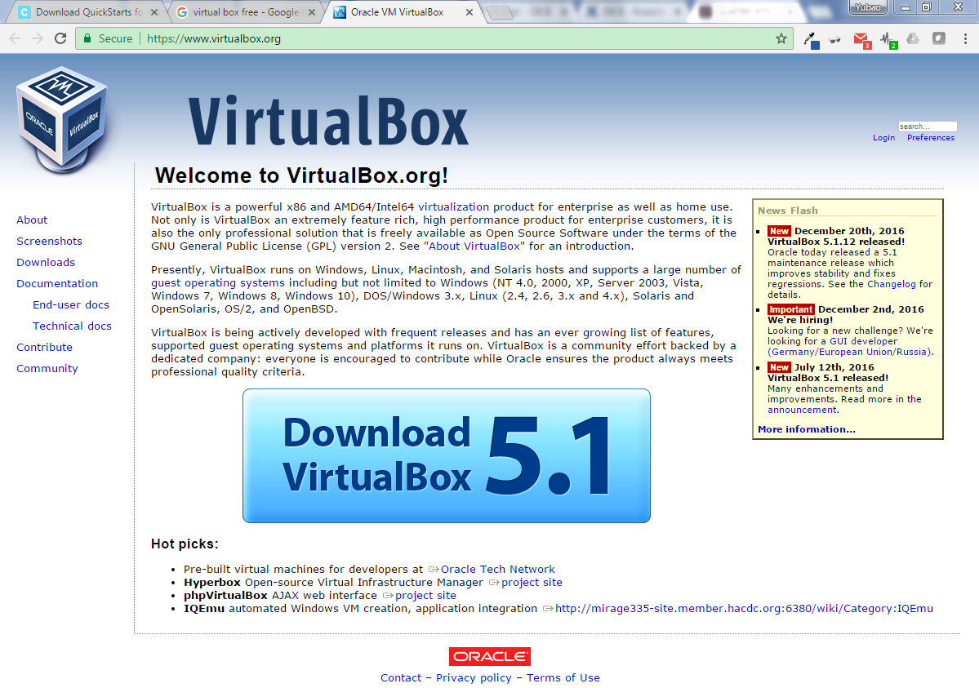

Slide 5
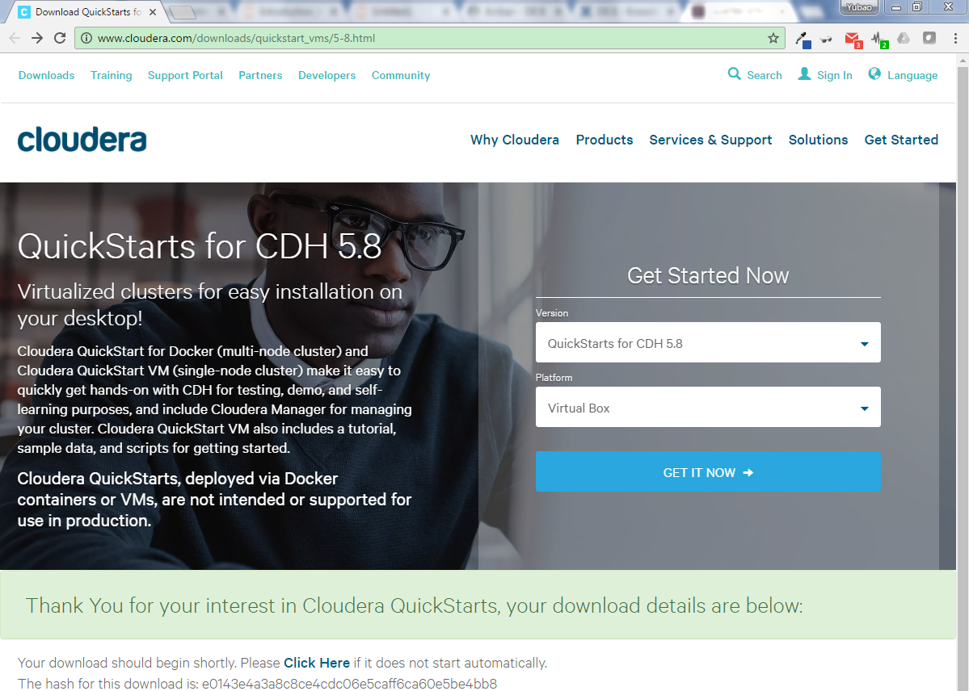

Slide 6
The DICE Cluster
Email from hpctech@rs.gsu.edu
One account has been created for each student.
UserID: campusID
Password: Your password for your campusID
To access DICE, please refer to out links below:
DICE remote shell access:
https://dice.gsu.edu:8000/hub/login
DICE Data Intensive tools:
https://dice.gsu.edu/#/main/dashboard/metrics
Join DICE user group:
https://gsu-bdwg.slack.com/messages/@slackbot/
Knowledge Base:
https://researchsolutions.atlassian.net/wiki/display/PD/DICE

Slide 7
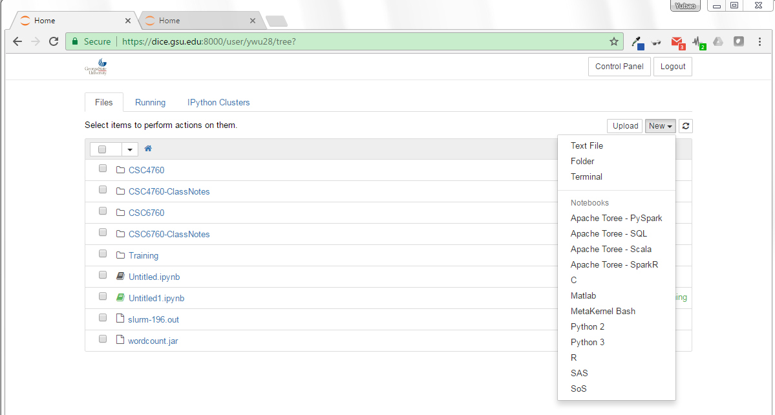
Run Hadoop on the DICE Cluster
DICE remote shell access:
https://dice.gsu.edu:8000/hub/login
Click on “New” => MetaKernel Bash

Slide 8
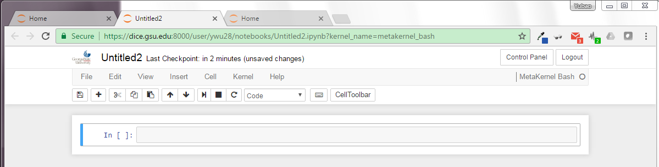
Run Hadoop on the DICE Cluster
Input your command to run Hadoop.
For example, type “Hadoop version”

Slide 9
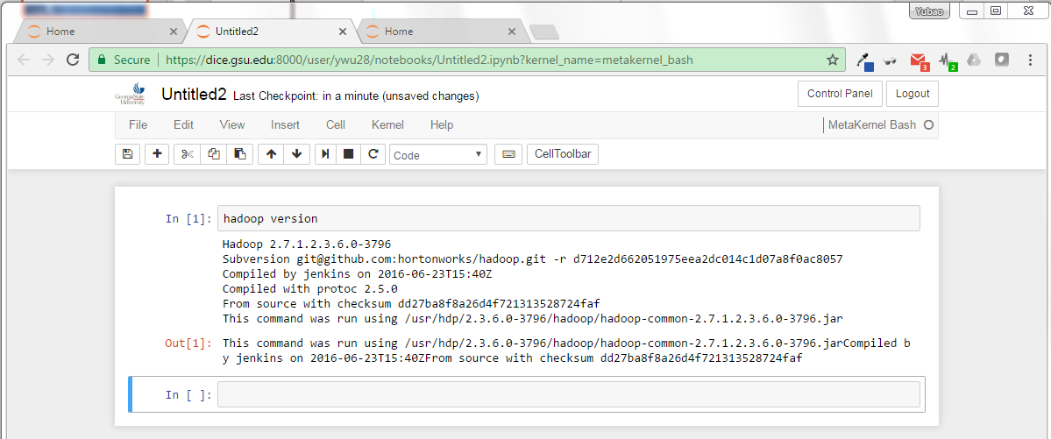
Run Hadoop on the DICE Cluster
Input your command to run Hadoop.

Slide 10
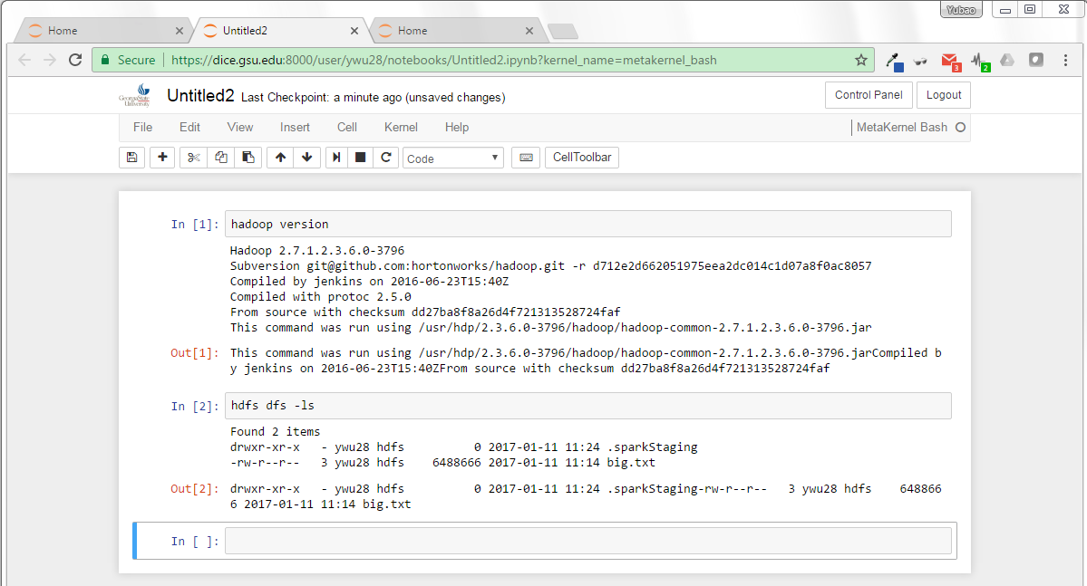
type “hdfs dfs -ls”

Slide 11
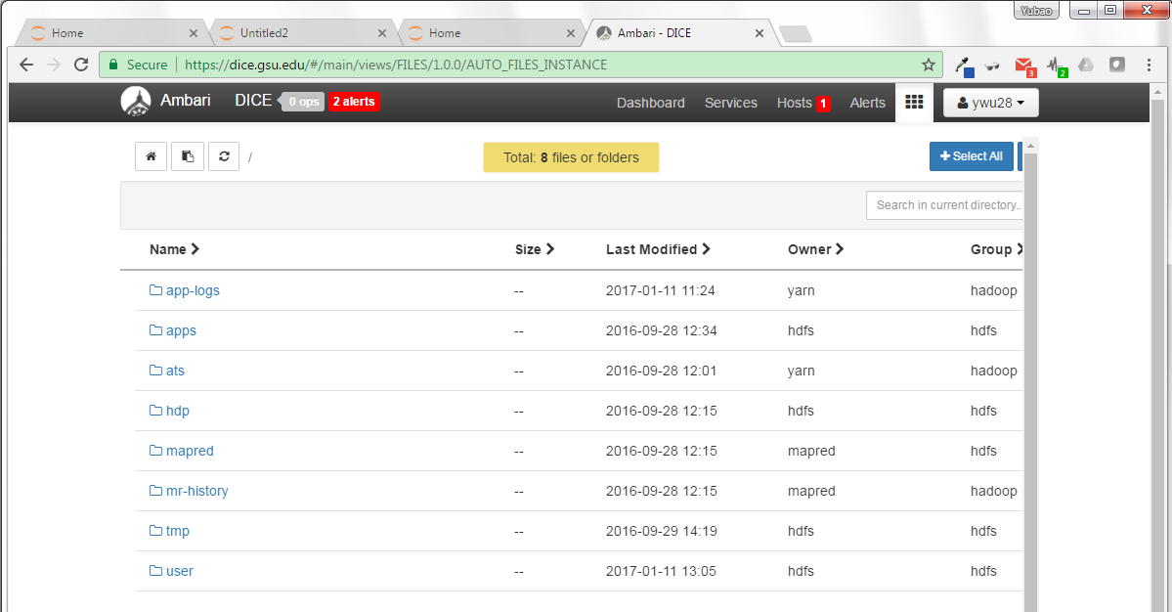
How to upload a dataset file to the DICE Cluster?
Click “file view”!
Click “User”-> click your name!

Slide 12
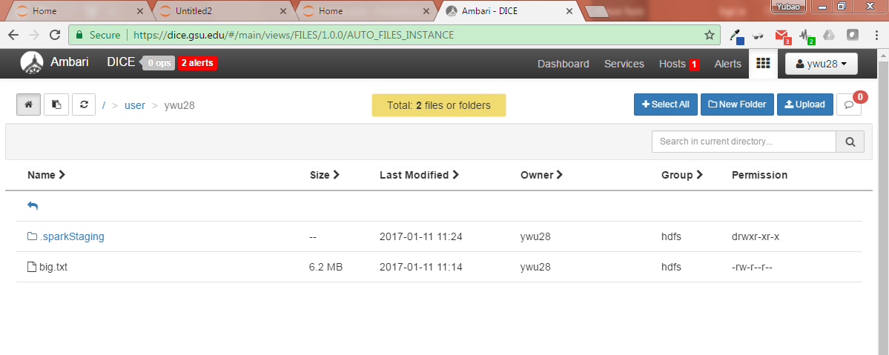
How to upload a dataset file to the DICE Cluster?
Click “Upload”-> your data file!

Slide 13
How to run Hadoop job
Type your source code in a Java IDE (like Eclipse Java)
Use Java IDE (like Eclipse Java) to create a “.jar” file
Upload the “.jar” file into DICE
Type “jar …” to run it.

Slide 14
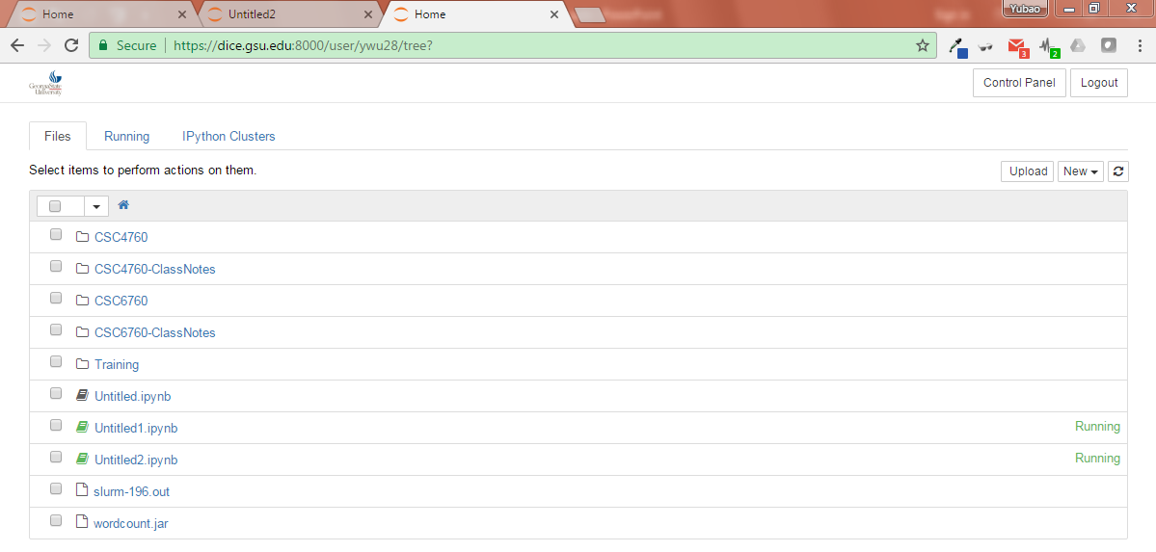
Upload a “.jar” file to DICE
Click “Upload”-> your .jar file!

Slide 15
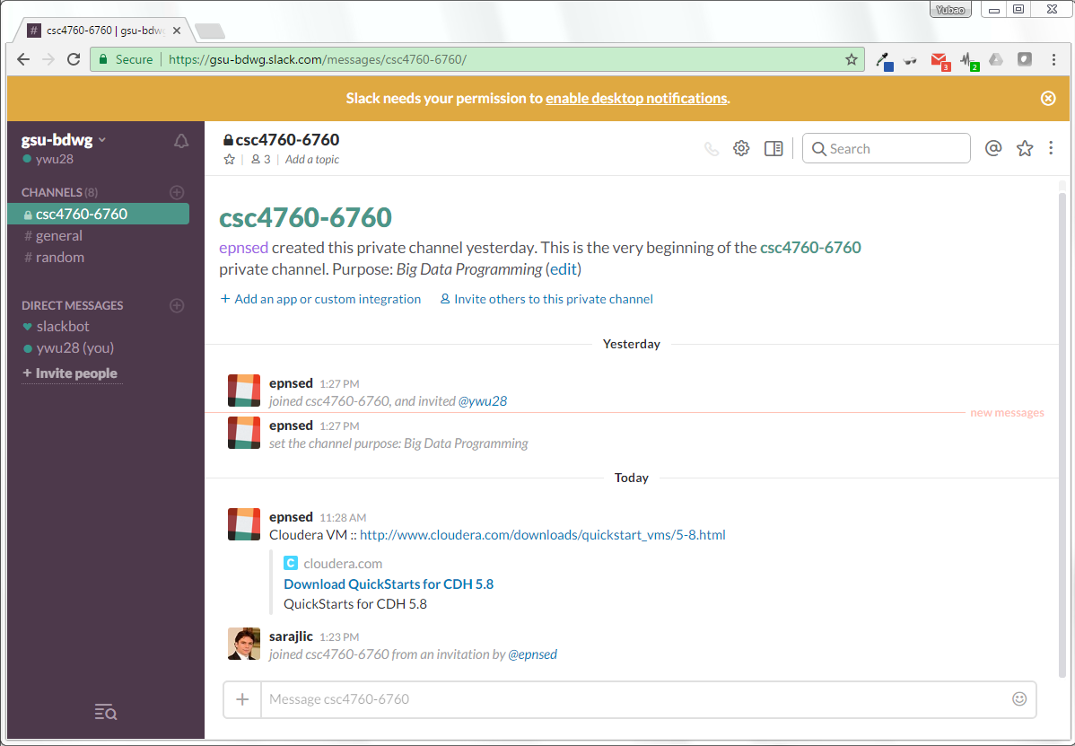
DICE User Group : the learning community

